Slide 1

Money Guru speed comparisons
Site performance improvements

Slide 2
Why did we do this work?
Research by Google (across all websites)
Conversion falls by 7% for each additional second of render speed (above 2 seconds)
53% of users will abandon a site if a page takes longer than 7 seconds to render
24% of UK traffic is via 3G on a mobile device
MoneyGuru Analytics data (19 Nov 2017)
82% of visits are from a phone (so it’s likely 19% use 3G)
Average render speed for pages is 10.2 seconds
Slowest 20 pages (including some filtered credit card tables) average 20.8 seconds
So it’s likely we lose around 50% of mobile customers before the page even loads

Slide 3
What’s being measured?
Loading and rendering speed for key pages
Site homepage
/loans
/compare-loans
/compare-credit-cards
/credit-cards/moneymatcher
/wisdom
/insights
The performance of our infrastructure
How many pages per second can we serve (based on concurrent requests for the same page)
How many decisions per second we can undertake (from MoneyMatcher Decision Engine)

Slide 4
How do we test infrastructure?
Test concurrent pages and Decision Engine requests
We produce 100 concurrent requests (many times more than we currently receive in real-world conditions) then record how the infrastructure copes with performing core functions
Various scenarios
An artificially created simple HTML page (for benchmarking purposes only)
A more complex PHP page undertaking minor processes
The MoneyMatcher Decision Engine – the most complex and data-heavy element of the site

Slide 5
What have we improved?
Six critical areas
Visual design of areas that perform slowly
Front-end code across the entire site
Test environment
Back-end code across much of the site
Decision Engine
Infrastructure
Implemented changes to our processes
Building performance enhancement into everything we do
User validation (A/B and other user approval tests) for all future changes

Slide 6
1: Design improvements
Most design changes are driven by function
New features introduced during the performance improvements work (around Credit Card tables)
Changes to Credit Card tables made other changes necessary (e.g. Provider Profiles)
Some changes are related to performance
Improving rendering speed by delivering the same information in more efficient ways
Creating re-usable components that allow better caching of CSS and HTML
Plus significant changes to meet roadmap requirements for future table features
Major elements updated
Money Matcher forms – faster, easier to use, optimised for mobile
Results pages - tables optimised for mobile and lazy-loading, new filtering and data/page loading
Navigation – optimised for speed and mobile
Category landing pages – optimised for mobile and SEO
Provider pages – optimised for mobile, removed unworkable product tables

Slide 7
2: Front-end code improvements
Built for mobile
82% of our visitors use mobile, so the new site design is “mobile first”
Re-written the entire front-end code
Developed our own HTML/CSS framework which renders much faster than the old one
Reduced core CSS from around 280k to around 50k
Asynchronous loading – renders important content ASAP so user can interact before page is complete
Changed the way JavaScript is loaded into pages
Introduced more efficiency into the JS, and how it’s used
Reduced “presentation” JS (used to control things like modals and menus) from 73k to 7k
Removed legacy JS (ongoing work)

Slide 8
3: Test environment improvements
Automated testing
Testing scripts to automatically re-test the site as we proceed, reducing manual testing time and improving accuracy
Test wrapper
Written a “wrapper” that controls alternative versions of pages, so we can manage how they’re split-tested, and gain better insights into the best-performing variation(s) without users seeing “?v2” or similar
Planning further integrations with AdWords and Google Experiment, so we can manage A/B/n and split-tests more effectively
Planned an ongoing process of Split tests (to assess which overall design users prefer) and A/B/n tests (to test individual components within a page)

Slide 9
4: Back-end improvements
Re-engineered the way data is loaded into pages
More of the calculations are now done on the server (fast), rather than the users’ computer (slow)
Reduced the amount of data loaded, by eliminating duplication and unused legacy data
Example: the “More info” data is only loaded when the user requests it, saving a lot of load-time
Lazy-loading
Only 5 results are loaded when the page opens, so the page renders faster on first-load
More results load automatically as the user scrolls
Results begin loading before the user scrolls to them, so they’re “ready” before needed

Slide 10
5: Decision Engine improvements
Re-engineered the Decision Engine code and logic
Changed the way we approach the Decision Engine coding, to improve logic
Re-coded the Decision Engine to improve performance
Increased Decisions Per Second
Previously could only handle 1 decision per second (based on 100 concurrent requests)
Can now handle 100 decisions per second
Performance has been increased 100x

Slide 11
6: Infrastructure improvements
Upgraded PHP to version 7.2
A faster, more modern version of PHP
Migrating to faster servers

Slide 12
What conversion improvements can we expect?
These projections are based on research by Google into typical conversion and bounce rate improvements, applied to our target speed improvements
* Google research suggests our reported bounce-rate from GA is probably inaccurate, because 53% of people abandon a page that takes longer than 7 seconds to load. This is before GA loads, so the data isn’t recorded.
 | Now | Worst case | Average | Best case | Best improvement
Bounce rate* | 53% | 40% | 27% | 12.8% | 80% reduction
Conversion rate | 0.4% | 0.9% | 1.4% | 1.9% | 400% increase

Slide 13
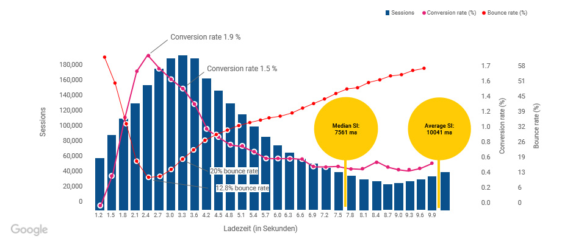
Google page-speed research

Slide 14
Before and after
Comparisons for key page speeds

Slide 15
How do we test page speed?
Independent speed testing service recommended by Google
www.webpagetest.org/mobiletest
Set to emulate real-world connectivity and servers
Set to average 3G data speed of 1.6Mbps (used for 24% of mobile data connections in the UK)
Behaves as if hosted in London

Slide 16
What isn’t included?
These tests were done on the feature server http://feature.moneyguru.com/
The live site was uploaded to that server and tested
Then the new site was uploaded to that server and tested
This ensures a like-for-like test
The feature server does not include the infrastructure changes we have made
Still uses the old version of PHP, and doesn’t have any of the other infrastructure improvements we’ve added to the project
The speed test improvements are not yet complete
Quite a lot of unnecessary legacy code still remains – we will continue to remove it
Speed improvements will become even greater

Slide 17
What does the page speed data mean?
Start render | The moment the page first begins to render content onto the screen. Until this moment, the page is blank.
Visually complete | The moment visual elements of the page have rendered.
Fully loaded | The moment the page has completed loading all data, including tracking code.
Speed index | An average (in milliseconds) across all devices, connection speeds and screen resolutions. This indicates the moment the page has finished rendering within the viewport (i.e. the parts of the page which are visible without scrolling). Not necessarily the same as “fully loaded”, but is indicative of the time when an average user can begin using the page.
Video | A video clip of each page, showing a real-world loading experience for an iPhone 7 using 3G. The video turns black and white when the page has completed loading.

Slide 18
Homepage
 | Old site | New site | Improvement (sec) | Improvement (%)
Start render | 4.7 | 1.8 | 2.9 | 62%
Visually complete | 13.8 | 8.2 | 5.6 | 41%
Fully loaded | 17.1 | 9.9 | 7.2 | 42%
Speed index | 5505 | 3991 | 1514 | 28%

Slide 19

Old site
New site

Slide 20
/loans
 | Old site | New site | Improvement (sec) | Improvement (%)
Start render | 4.3 | 1.9 | 2.4 | 56%
Visually complete | 13.0 | 9.0 | 4.0 | 31%
Fully loaded | 16.2 | 11.6 | 4.6 | 28%
Speed index | 5680 | 4290 | 1390 | 24%

Slide 21

Old site
New site

Slide 22
/compare/personal-loans
 | Old site | New site | Improvement (sec) | Improvement (%)
Start render | 4.5 | 1.9 | 2.6 | 58%
Visually complete | 14.4 | 3.9 | 10.5 | 73%
Fully loaded | 20.1 | 10.4 | 9.7 | 48%
Speed index | 9349 | 2691 | 6658 | 71%

Slide 23

Old site
New site

Slide 24
/compare/credit-cards
 | Old site | New site | Improvement (sec) | Improvement (%)
Start render | 4.6 | 2.1 | 2.5 | 54%
Visually complete | 17.9 | 7.4 | 10.5 | 59%
Fully loaded | 24.2 | 8.2 | 16 | 66%
Speed index | 6835 | 4302 | 2533 | 37%

Slide 25

Old site
New site

Slide 26
/credit-cards/moneymatcher
 | Old site | New site | Improvement (sec) | Improvement (%)
Start render | 3.8 | 1.9 | 1.9 | 50%
Visually complete | 15.2 | 8.8 | 6.4 | 25%
Fully loaded | 18.8 | 12.2 | 6.6 | 35%
Speed index | 6413 | 4442 | 1971 | 31%

Slide 27

Old site
New site

Slide 28
/wisdom
 | Old site | New site | Improvement (sec) | Improvement (%)
Start render | 4.2 | 1.7 | 2.5 | 60%
Visually complete | 12.4 | 3.0 | 9.4 | 76%
Fully loaded | 15.1 | 8.2 | 6.9 | 46%
Speed index | 4751 | 2786 | 1965 | 41%

Slide 29

Old site
New site

Slide 30
/insights
 | Old site | New site | Improvement (sec) | Improvement (%)
Start render | 4.5 | 1.8 | 2.7 | 60%
Visually complete | 13.2 | 9.2 | 4.0 | 30%
Fully loaded | 16.1 | 10.0 | 6.1 | 38%
Speed index | 5253 | 4660 | 593 | 11%

Slide 31

Old site
New site

Slide 32
Time to Interactive (BETA)
 | Old site | New site | Improvement (sec) | Improvement (%)
Homepage | 13.7 | 5.8 | 7.9 | 58%
/compare/credit-cards | 15.3 | 8.2 | 7.1 | 46%
Time to Interactive
This is a new metric from www.webpagetest.org. It indicates when the page is first expected to be rendered, consistently usable, and can respond to input quickly (with the possibility of slow responses as more content loads).
All measurements are based on average 3G data speed of 1.6Mbps.
This measurement is new, and in BETA. Running the test currently takes around an hour per page, so we have focussed on only two key pages as an indication of general performance improvements.

Slide 33
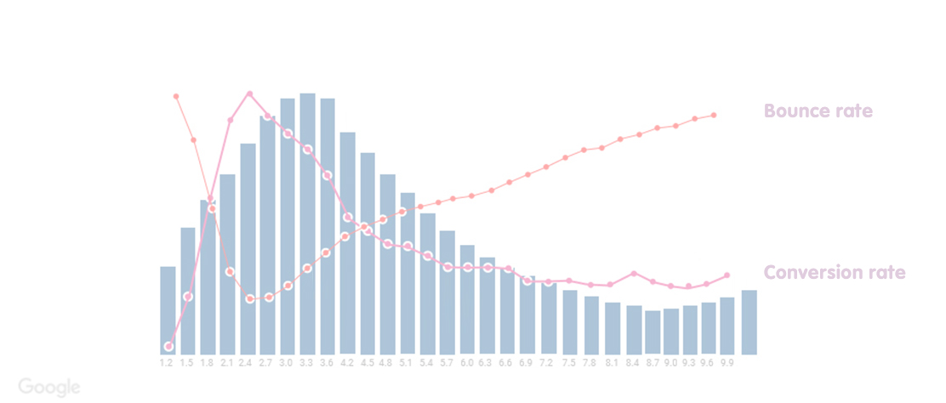
Conversion rate improvement
Based on Average first render time across the pages measured, mapped to Google data
New site
Old site
New conversion
Current conversion

Slide 34
How we compare with other sites
Comparing the new homepage with leading competitor homepages

Slide 35
Speed Index comparison (homepages)
 | Competitor | Old MG | Difference | New MG | Difference
MoneySuperMarket | 11016 | 5505 | 50% | 3991 | 61%
Money | 4522 | 5505 | -22% | 3991 | 12%
Totally Money | 5140 | 5505 | -6% | 3991 | 28%
Go Compare | 5290 | 5505 | -4% | 3991 | 29%
Speed Index
An average (in milliseconds) across all devices, connection speeds and screen resolutions.
This indicates the moment the page has finished rendering within the viewport (i.e. the parts of the page which are visible without scrolling). Not necessarily the same as “fully loaded”, but is indicative of the time when an average user can begin using the page.

Slide 36
A great first step…
Further performance enhancements can be made
This quarter we have tackled major issues we knew we could resolve before the TV campaign begins
We have made significant improvements to areas most likely to produce big performance results
Future improvements may be smaller and more incremental, but are still important
Next steps…
Launch the site and continuously measure improvements
Identify what we can improve in the next quarter
Continue to test design enhancements with our users, to make sure our assumptions are validated
Build performance improvement into each new enhancement and feature we add
Include performance tests as a continuous element of automated testing prior to each release

Slide 37
Thank you
Any questions?

Slide 38
Design improvements (detail – remove if unnecessary)
Homepage
Cleaner design on mobile
Better CTA, with all propositions visible without scrolling
Leverage Feefo and our providers’ names on the homepage to build trust and boost SEO
Money Matcher
Designed to work better on mobile – less fussy design, clearer messaging
Input fields are easier to tap – a larger, cleaner design which is better for mobile users
Less scrolling, clearer messaging, easier inputs for complex data (DOB, Address)
Loads faster, updates faster, returns results faster

Slide 39
Design improvements (detail – remove if unnecessary)
Results pages, tables and filtering
Cleaner design to provide more appealing retail proposition
Displays contextual product data - relevant to the product, informative for the user
Easier results filtering
Better messaging and use of space, especially on mobile
Category landing pages
Clearer design with a single CTA above the fold
Each product now has a text description, to boost SEO and explain the offering better
Design is more consistent with the rest of the site, and loads faster

Slide 40
Design improvements (detail – remove if unnecessary)
Providers
Improved and cleaned the layout for the providers landing page
Removed duplicated “results” from provider page, which never worked properly
Replaced this with list of products, with text associated to help boost SEO and explain the offering better
Ideation and validation
Over 50 design concepts were created prior to implementing these changes
Ongoing process of split-testing design changes to validate and continuously improve
Concepts have been created for future proposed roadmap requirements, so we know it’s future-proofed

